Slide 1
CS543: Printed Music Sheet Recognition
Felicia Chandra (fchandr2), Hao Zhang (hzhang49), Yaning Liang (liang33)

Slide 2
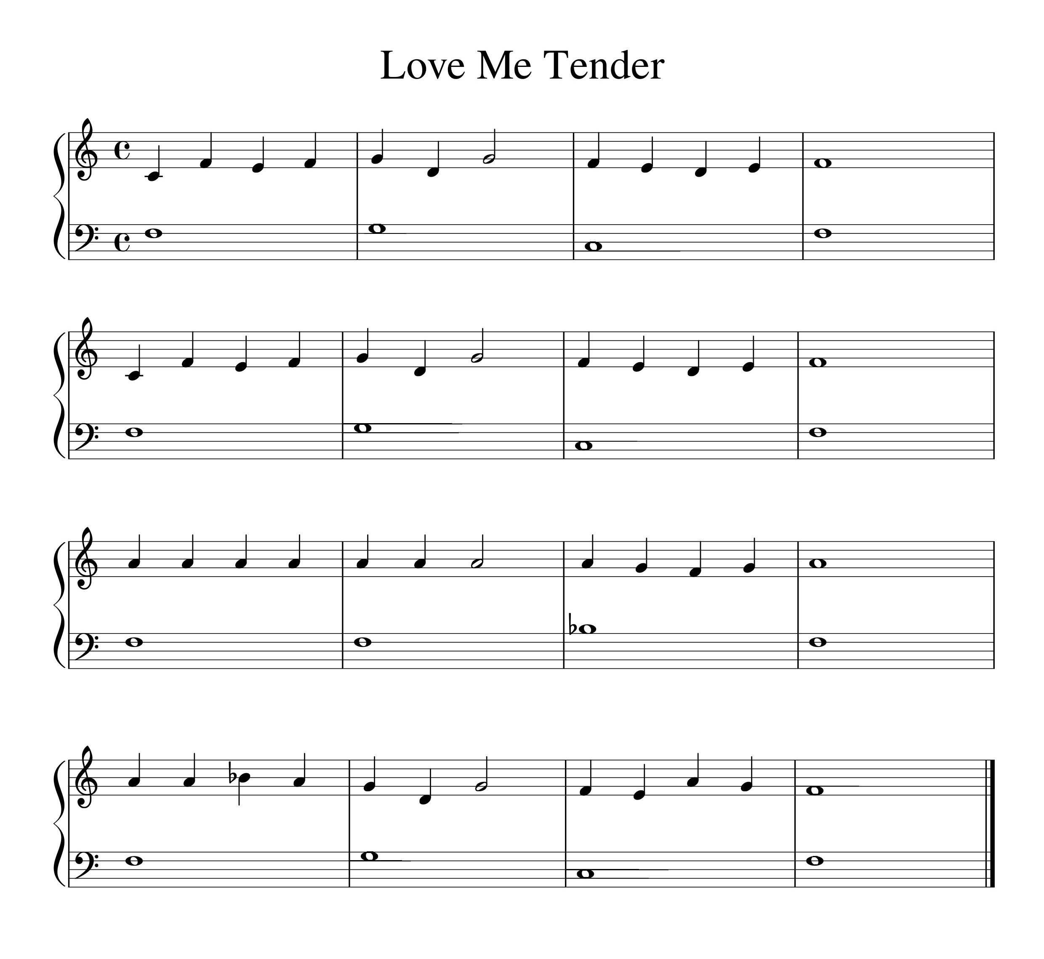
project definition
Goal: Interpret a music sheet into a playable music.
Input: Printed music sheet
Output: Play the musical
tones

Slide 3
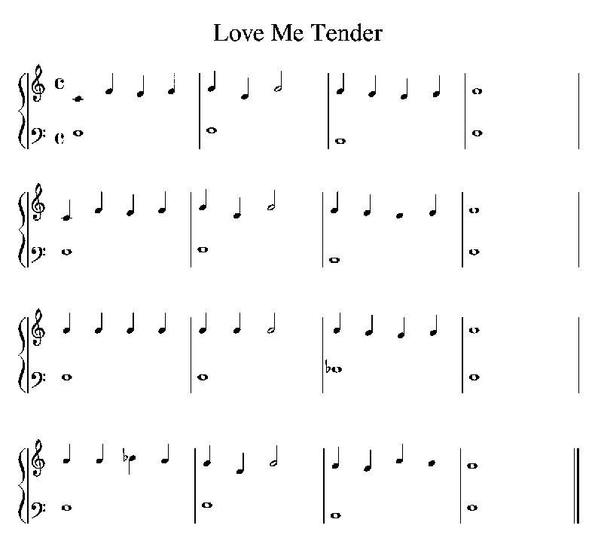
Staff lines detection and removal
Detect the location of all staff lines.
Remove staff lines.
Fill in the gap.

Slide 4
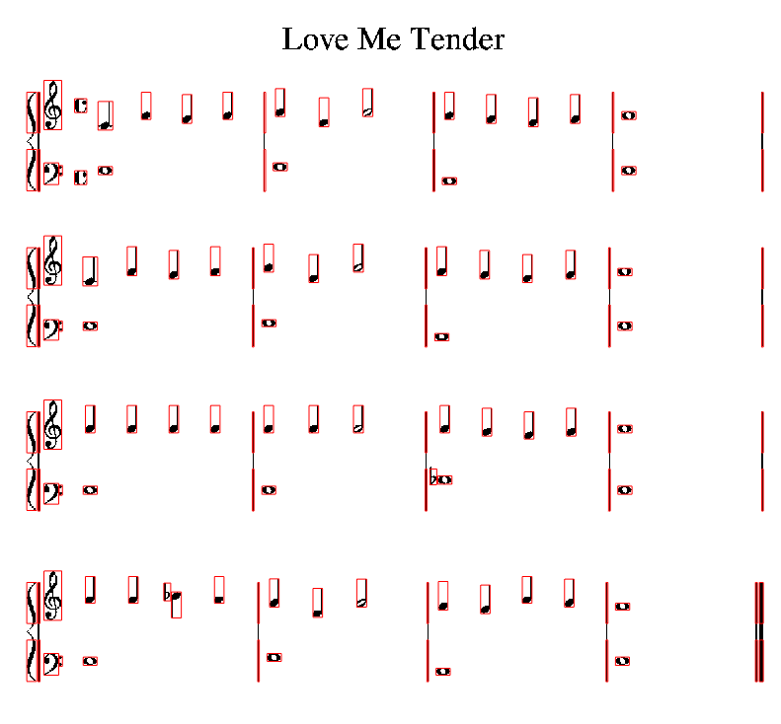
Segmentation
Process row by row.
Calculate boundaries for each symbol.
Extract symbol.

Slide 5
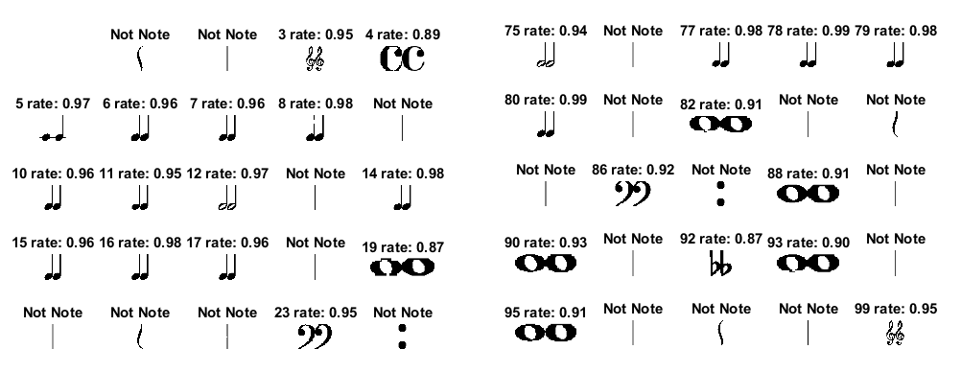
Symbol Recognition
Calculate matching score against each training image.
Minimum score threshold: 80%.
Pick a label with maximum score.

Slide 6
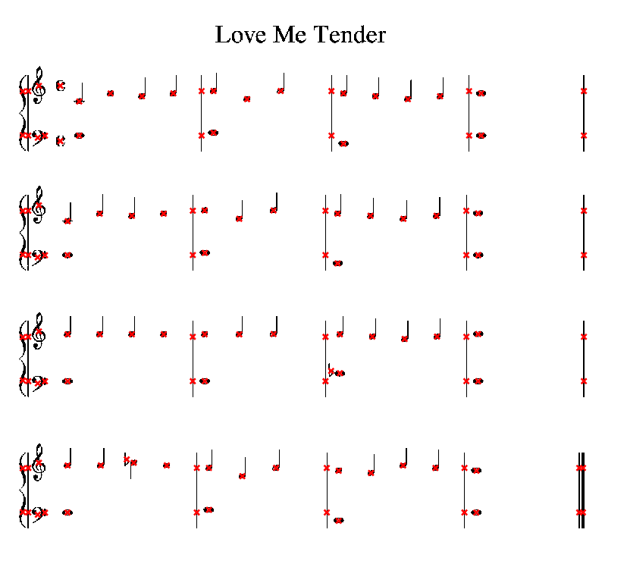
Note Identification
Calculate center point coordinate.
Compare with staff lines coordinates to get the pitch.
Use recognition label to get the duration.

Slide 7
Music transformation
Generate sound data.
Play the song.
Demo videos:
  https://drive.google.com/file/d/0B62GthhfesJ-WkdBWVFVb3RwWEE/view?usp=sharing
  https://drive.google.com/file/d/0B62GthhfesJ-dlg1SUlXQjJzbWM/view?usp=sharing

